Slide 1

AI-VisionExtract: Isolation from Images using Image Segmentation
BY
B.NAGA SAI LAKSHMI

Slide 2

Introduction
Transforming Image Processing with AI
VisionExtract represents a cutting-edge solution for automated subject isolation using advanced image segmentation techniques. This project leverages deep learning to intelligently separate foreground subjects from backgrounds, creating precise cutouts with minimal manual intervention.
The technology bridges computer vision research with practical applications in photography, media production, and digital content creation, demonstrating the real-world impact of semantic segmentation models.

Slide 3

Problem Statement & Objectives
The Challenge
Our Goal
Core Objectives
Manual subject isolation is time-consuming and requires expertise. Existing tools lack precision for complex boundaries like hair, fur, or transparent objects. Automation is essential for scalable media workflows.
Build a machine learning model that automatically extracts the main subject from any image, rendering the background completely black whilst preserving the subject's original appearance with pixel-perfect accuracy.
Implement semantic segmentation using deep learning
Achieve high-precision subject-background separation
Deploy a practical, user-friendly solution

Slide 4





Use Cases & Applications
Photography Automation
Virtual Conferencing
Streamline post-production workflows by automatically removing backgrounds from product photos, portraits, and commercial photography without manual masking.
Enable real-time background replacement for video calls and virtual meetings, enhancing privacy and professionalism in remote communication.
AR & Digital Art
E-commerce & Retail
Support augmented reality applications and digital content creation by providing clean subject extraction for compositing and special effects.
Automate product image preparation for online catalogues, ensuring consistent white or transparent backgrounds across thousands of product listings.

Slide 5





Project Architecture
Data Ingestion
Preprocessing Pipeline
COCO 2017 dataset with images and segmentation masks
Normalisation, augmentation, mask alignment
Segmentation Model
Subject Isolation
Deep learning architecture for pixel-wise prediction
Binary mask application and output generation
The architecture follows a modular design, enabling flexibility in model selection and deployment whilst maintaining robust performance across diverse image types and subject categories.

Slide 6

Dataset & Technical Foundation
COCO 2017 Dataset
The Microsoft Common Objects in Context (COCO) dataset provides comprehensive annotations for training robust segmentation models:
Over 200,000 labelled images with diverse scenes and subjects
80 object categories including people, animals, vehicles, and household items
Pixel-level segmentation masks for precise boundary definition
Real-world complexity with occlusions, varying scales, and challenging backgrounds
This rich dataset ensures the model generalises well to unseen images across different domains and use cases.

Slide 7
Existing vs. Proposed System
Existing Systems
Proposed VisionExtract System
Manual Editing Tools: Require skilled operators and significant time investment for each image. Inconsistent results depend heavily on user expertise.
Deep Learning Automation: Leverages state-of-the-art semantic segmentation for consistent, high-quality results without manual intervention.
Basic Threshold Methods: Struggle with complex backgrounds and fine details like hair or semi-transparent objects. Limited to simple, high-contrast scenarios.
Pixel-Perfect Precision: Handles complex boundaries, fine details, and challenging scenarios through learned feature representations.
Commercial APIs: Often expensive with usage limits, lack customisation options, and raise privacy concerns for sensitive images.
Customisable & Private: Deployable on-premises for data security, fully customisable for specific use cases, with no per-image costs after training.

Slide 8
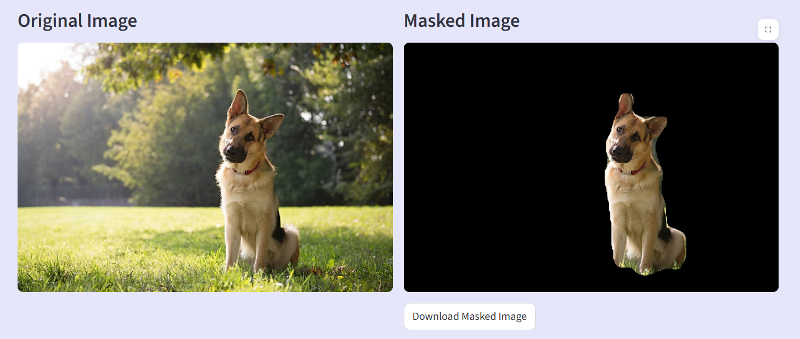
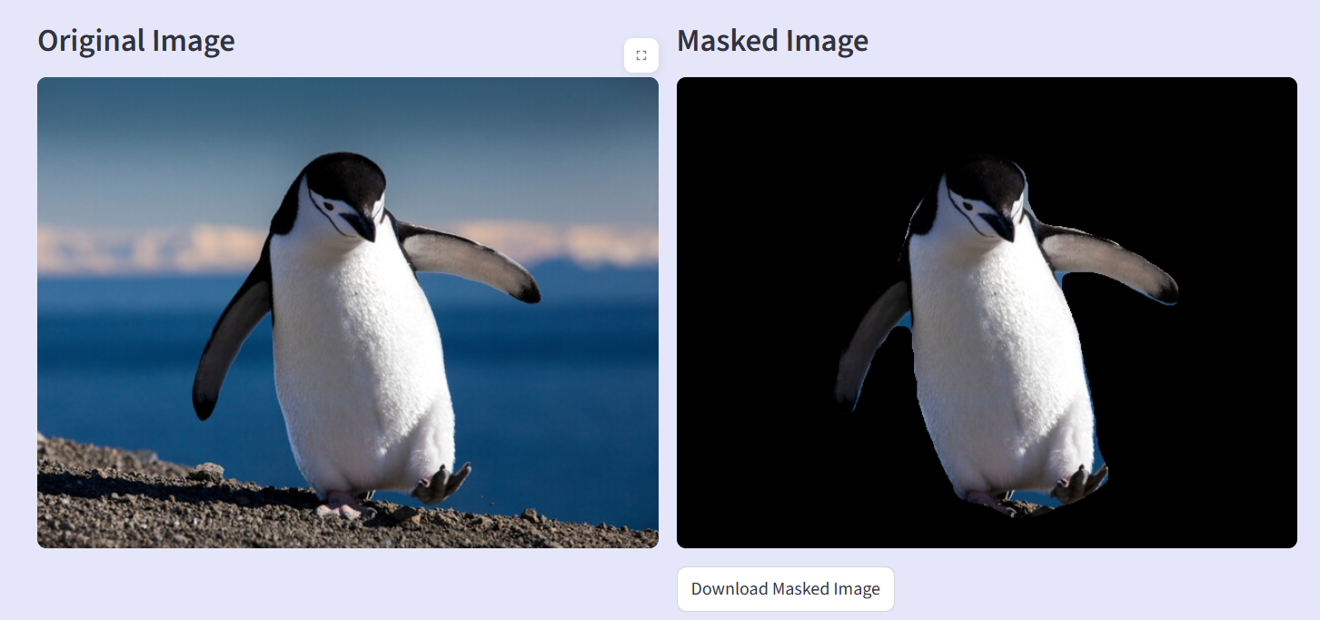
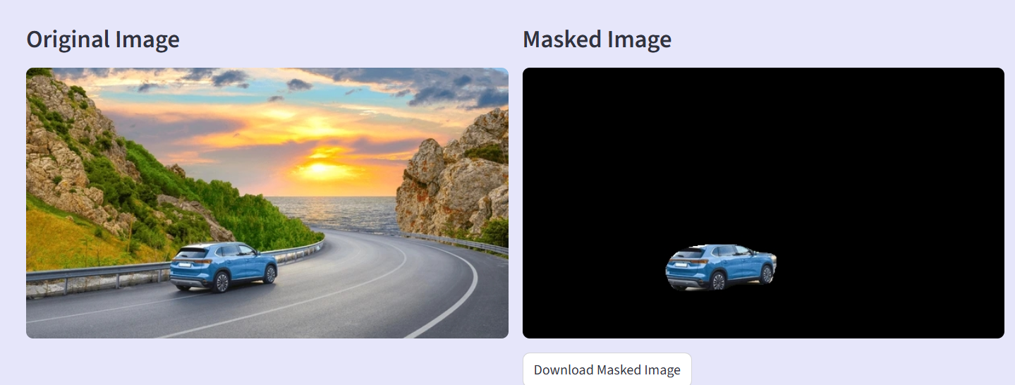
Results

Slide 9
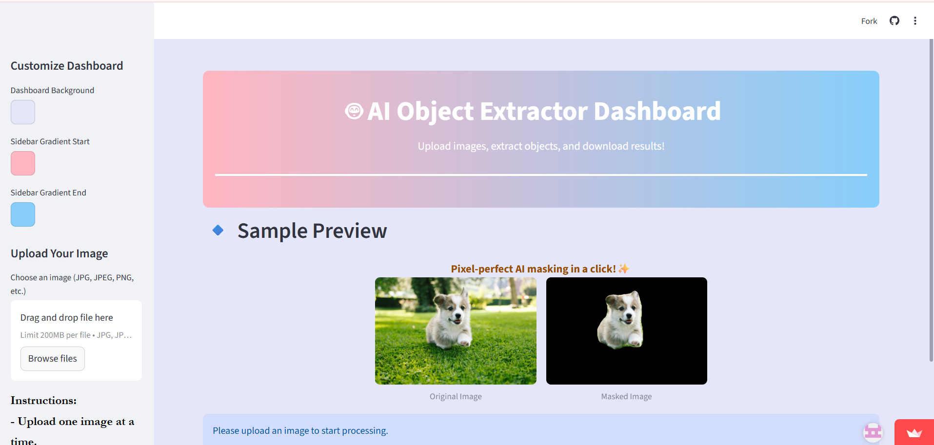

Slide 10

Methodology: Building the Pipeline
01
02
Data Preprocessing & Feature Engineering
Segmentation Model Development
Ensure resolution consistency between images and masks, apply augmentation techniques (cropping, flipping, colour perturbation), normalise pixel values, and convert multi-class masks to binary subject-background format for training.
Implement deep learning architecture (e.g., U-Net, DeepLab) to predict pixel-wise binary masks. The model learns to distinguish subject pixels from background through supervised training on annotated data.
03
04
Training & Optimisation
Evaluation & Fine-tuning
Train the model using appropriate loss functions (binary cross-entropy, Dice loss) and optimisation strategies. Monitor validation performance and adjust hyperparameters to prevent overfitting whilst maximising accuracy.
Assess performance using IoU, Dice coefficient, precision, recall, and pixel accuracy metrics. Review qualitative outputs to identify edge cases and refine the model through iterative experimentation.

Slide 11

Key Features & Advantages
Automated Precision
Achieves professional-quality subject isolation without manual editing, dramatically reducing production time and costs.
Robust Generalisation
Trained on diverse imagery, the model handles various subjects, poses, and backgrounds effectively.
Scalable Processing
Process hundreds or thousands of images consistently, enabling batch operations for commercial applications.
Fine Detail Preservation
Captures intricate boundaries including hair, fur, and semi-transparent elements that challenge traditional methods.

Slide 12





Future Scope
Augmented Reality (AR) Seamlessly place isolated subjects into real-world views without disruptive backgrounds.
.
Virtual Conferencing
Provide high-quality, precise background replacement during video calls (e.g., virtual green screens).
Photography Automation
Streamline workflow for product photography and portrait post-processing, saving significant manual effort.
Digital Art & Design
Quickly separate elements for collage, digital painting, and graphic design projects.

Slide 13

Key Challenges & Solutions
Complex backgrounds: Addressed through extensive data
augmentation and robust architecture selection
Fine detail preservation: Implemented multi-scale processing
and attention mechanisms for boundary refinement
Computational efficiency: Optimised model architecture for
real-time inference whilst maintaining accuracy
Edge and Boundary Accuracy : Achieving sharp subject
boundaries was challenging, as the model often produced
soft or incomplete edges, especially in complex background
or low-contrast regions.

Slide 14


The project “AI VisionExtract: Isolation from Images using Image Segmentation” successfully achieved automated subject isolation using deep learning–based semantic segmentation techniques. The model effectively identifies and extracts the main subject from an image, removing the background with high visual accuracy.
This work demonstrates the practical potential of computer vision in digital media, augmented reality, and virtual conferencing applications. The project also establishes a strong foundation for future advancements such as real-time segmentation, multi-class object isolation, and model deployment on edge devices.

Slide 15


